Slide 1
Boosting Self-Esteem After Bariatric Surgery with Cognitive Behavioral Training!
Presented by Dawn O’Meally, MSW, LCSW-C, P.A.

Slide 2
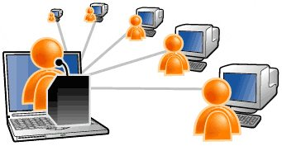
What you will learn from attending my presentation today!
Cognitive Behavioral Therapy (aka CBT) is a GAME CHANGER to help people take charge of their lives. It’s the secret sauce!
How CBT works to help people change and get control of unwanted and unhealthy thinking, feelings and habits that sabotages weight loss
Tips on Improving Your Self-Esteem!!!
Dawn’s experience using CBT in her work with Bariatric patients since 2005 & patient testimonials
POWERFUL CBT group education programs available to NOW on ZOOM

Slide 3
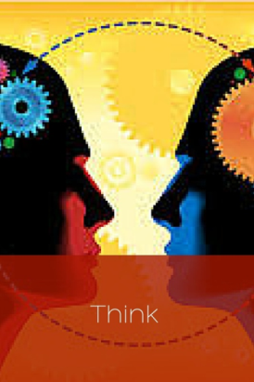
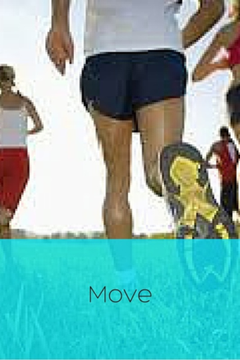
All 3 ingredients work together synergistically…but Thoughts come First . CBT programs the Mind to align behaviors to the desired outcome CBT lives in the THINK category.
The 3 Ingredients for Successful Weight Loss:
EAT
THINK
MOVE

Slide 4
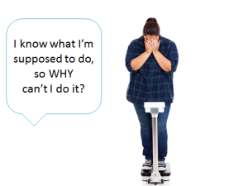
SOUND FAMILIAR? How many of you have said this to yourself?

Slide 5
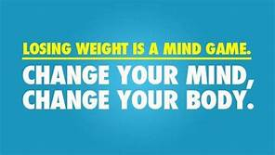
The Self Sabotaging, Negative Mindset is the #1 Cause of “Diet Failure”
If your correct your mind, the rest of your life will fall into place” ~Lao Tzu

Slide 6
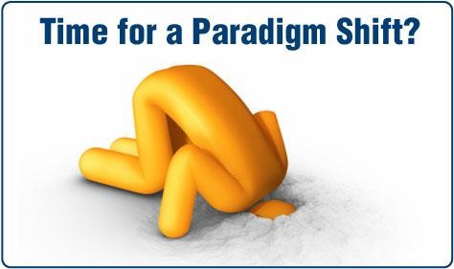
We NEED a Paradigm Shift when it comes to addressing
Being overweight and unhappy are not just eating or mood disorders, they are also “THINKING DISORDERS”
Diets, Pills, Potions, even Weight Loss Surgery won't Fix it. Your Mind is your most important Weapon!

Slide 7
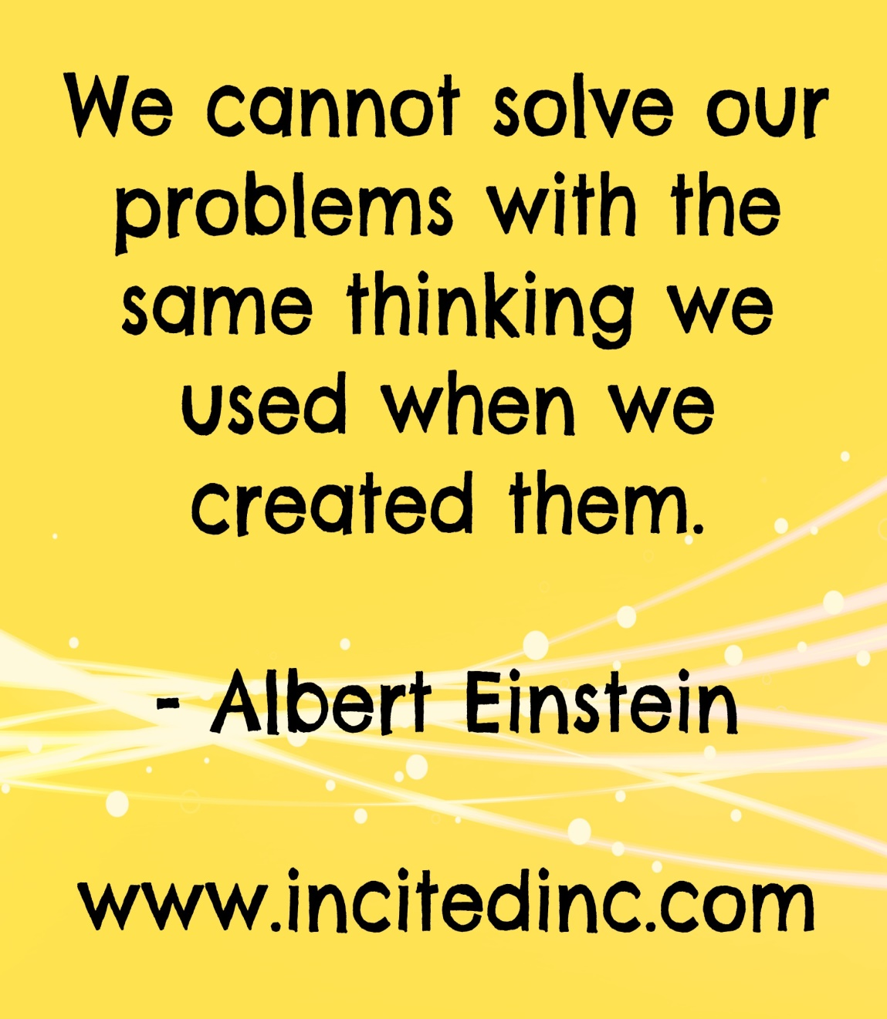
As it relates to weight loss… the mind is the leader of all actions. Actions are the direct result of Mind over Thoughts. Negative mind-Negative life.

Slide 8
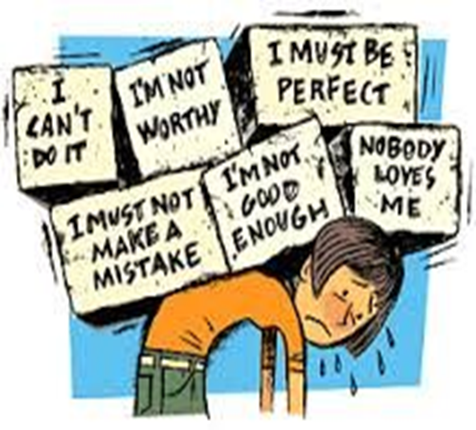
Most people do not consider that Thoughts Come First. Behaviors Come Second.
Negative, critical self talk, repeated weight loss failures, unrealistic expectations all contribute to the problem! Bariatric patients carry A LOT of these negative thoughts don’t they?

Slide 9
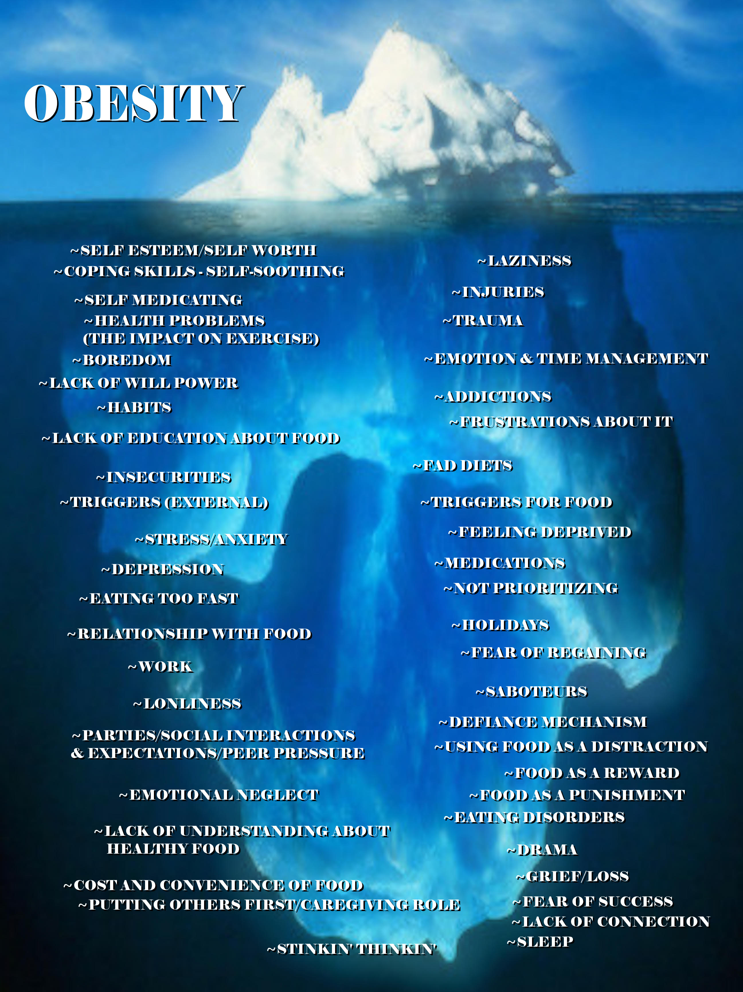
Consider what’s below the iceberg of Obesity and what Bariatric patients are really dealing with. Look what is at the top of the list: self- esteem/self worth. We can’t expect WLS to fix these things, but CBT can really help!

Slide 10
Developed by Dr. Arron Beck in the early 1960’s
CBT Produced a REVOLUTION in the Field of Mental Health!
Here and Now approach
Time limited, problem-solving approach
Empowering, don’t have to be dependent on a therapist forever!
Based on the concept that the way people think effects how they feel and what they do
Easy to learn-not psycho babble!
Helps patients literally rewire their brains and helps them achieve their goals! It is science based.
So what is CBT?

Slide 11
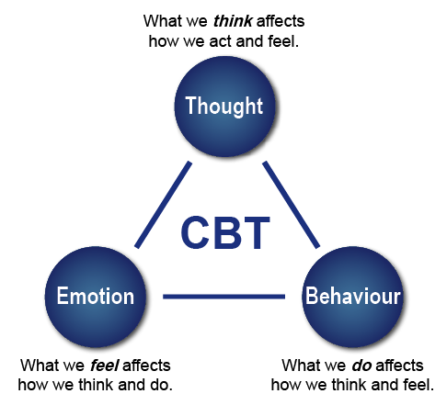
We do 3 things as Human Beings- Think, Feel, & Act Here is the CBT Model

Slide 12
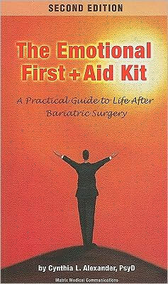
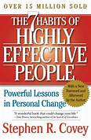
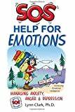
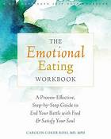
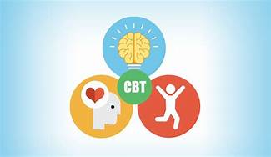
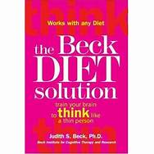
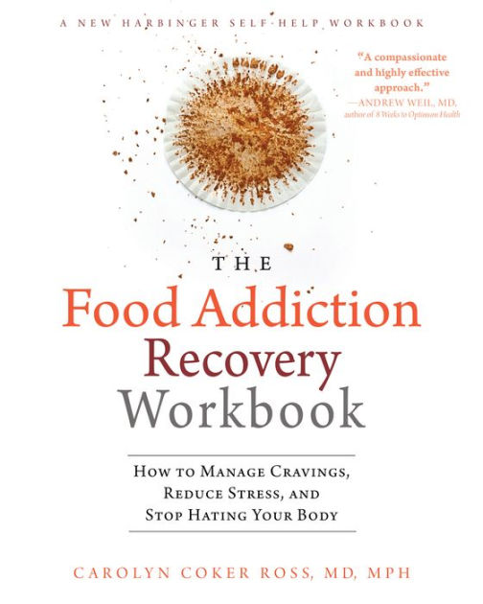
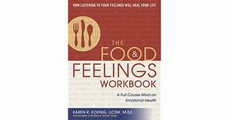
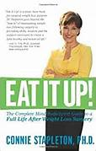
I teach powerful CBT group education programs to help Bariatric patients achieve their goals. I GROUPS!
But, my all-time favorite is …

Slide 13
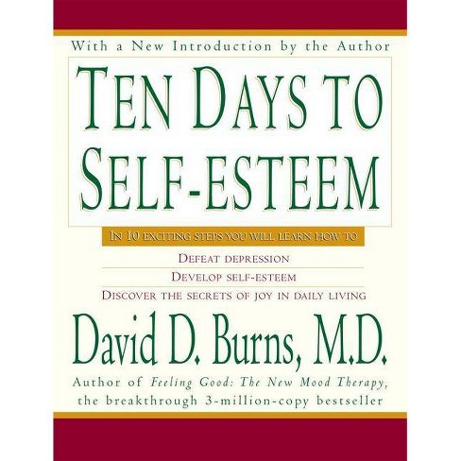
The program I created using this workbook, 11 Weeks to Self Esteem, is spot on for Bariatric patients. I have been teaching Dr. Burns’ CBT concepts in groups from this workbook since 2002 and have done hundreds of groups.

Slide 14
What do group members learn in 11 Weeks? SOOO MUCH! It’s incredible.
Methods to crush negative/distorted thinking that is self defeating and makes them feel stressed, depressed, anxious.
They complete tests each week that measure Depression, Anxiety, and Relationship Satisfaction levels. We see significant reduction in scores between week 1 & week 11.
How to complete the Daily Mood which transforms thoughts, feelings, behaviors.
How to break out of bad moods by challenging their cognitions to get unstuck.
Conditional vs. Unconditional self- esteem and self worth.
They learn they are not alone. Group is a no judgment zone!
How to manage their emotions more effectively vs. self soothe with food or alcohol.
How to stop the downward spiral that leads to unwanted consequences.
The difference between healthy and unhealthy feelings and what to do if they determine their feelings/thoughts/beliefs aren’t helping them using the Cost Benefit Analysis.
They learn 15 powerful techniques to untwist their negative thoughts, including using the Mirror technique to talk back to them.
How to overcome Perfectionism and Procrastination.
How to tame the inner critic beating them up and making it worse.
How to deal people pleasing, fear based thinking, fear of disapproval or criticism, fear of rejection
Fill Your Mind with Powerful Tools to fight the Weight Battle!

Slide 15
So…What’s the connection between weight loss and self-esteem?
Any ideas about this?

Slide 16
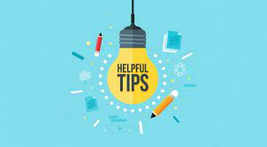
Tips for improving Self- Esteem!
Talk to yourself like you would a good friend. Stop beating yourself up!
Ditch the perfectionism.
Practice gratitude every day
Don’t get too far ahead of yourself. Patience is a virtue.
Focus on your progress, not the scale.
Stop comparing yourself to other people. Your journey is your journey!
Self Esteem is an inside out process. Don’t rely on other people to give you self esteem. You are the cake, other people are the icing.
Be careful about the I Am’s as they will come to get you!
Develop positive affirmations, write them down on index cards, and read them every day!
Get any mood issues treated by a professional.
Get support, give support-it feels good to give back!
Get into a CBT Group. It’s an awesome, life changing, experience!

Slide 17
What do participants say about the 11 Weeks to Self Esteem Course?
I am so glad that you suggested this to me. This has helped me so much. Sometimes I feel like a different person seeing life through a new pair of glasses-Jane
Your guidance of the group and your faithful encouragement were instrumental in creating a safe place to learn from Dr. Burns’ work-Nancy
You don’t get to be 300 lbs. without a lot behind it. I use to run to food for my emotions. They should require this before surgery. I think it’s unethical to do surgery before dealing with the head.-Wendy
I have gained such a different perspective on my problems and my outlook. I still have a lot of work to do, but I see the possibilities AND KNOW ANYTHING IS POSSIBLE! You have truly reached me in a way that no other therapist ever has, and I feel I am beginning a new chapter. I am eternally grateful-Kelly

Slide 18
Meet Dana
I started at 375.5 and with a hell of a lot of self esteem issues and super bad anxiety. I was wearing 4xl in men’s shirts, 52 in men’s pants. Now I wear 16/18 in women’s pants and an xl in women’s shirts. I’m down to 228. When you work on your mind you find the causes of why you ate the way you did, why you never put yourself first and why you thought you weren’t worth putting the work into yourself. I just completely the 11 Weeks to Self Esteem group program and that was SO LIFE CHANGING.

Slide 19
MEET Kristen, a graduate of the 11 Weeks to Self Esteem Program
https://youtu.be/xYuCz4QxXs0
“Now I have other ways to talk to myself to disprove the negative thoughts. I am dealing with my emotions vs. eating them. The program sets you up for success when you are on the downward spiral that leads to regain. My self talk was toxic.” -Kristen

Slide 20
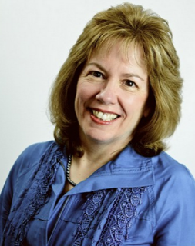
For more information about the online 11 Weeks to Self-Esteem Group Education Course, contact: Dawn O’Meally, MSW, LCSW-C dao@tcc4change.com
Check https://feelinggood.com/2021/04/26/239-ten-days-to-self-esteem-featuring-dawn-omeally/out the podcast

